Slide 1

Flask
Module 5

Slide 2
What is Flask?
Open Source Python based Web Application Framework
Collection of library, modules to write web application without having to bother about low level details such and protocol, thread management etc
Large Community collaborators
Inventor: Armin Ronacher with Team of Python enthusiast called Pocco
Flask is built on WSGI ( Web Server Gateway Interface, standard web development) Toolkit and Jinja2 Template Engine ( to render the HTML pages)
Adopted by Pinterest, LinkedIn
Micro Framework:Lightweight framework, provides essential components - routing, request handling, sessions

Slide 3
Features of Flask
Fast Debugging
RESTful request dispatching.
Application Programming Interface
Flexible configuration
Integrated Unit Testing
Notes:
https://www.youtube.com/watch?v=4L_xAWDRs7w

Slide 4
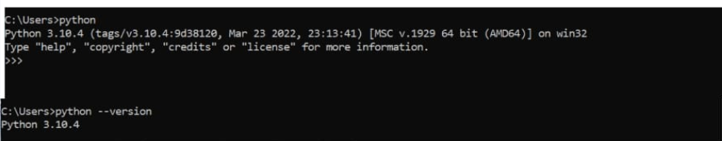
Installation
Prerequisite:
Download Python 3.7 or newer
https://www.python.org/downloads/ ( don’t forget to set PATH)
pip ( comes along with python)
Notes:
pip https://www.dataquest.io/blog/install-pip-windows/

Slide 5
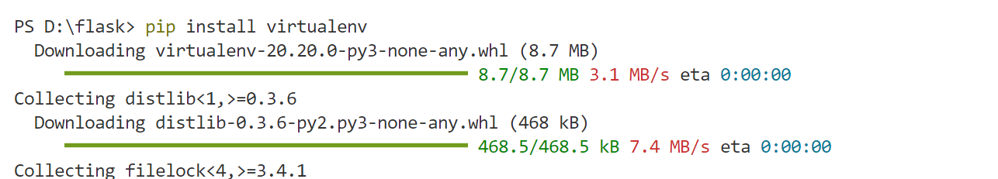
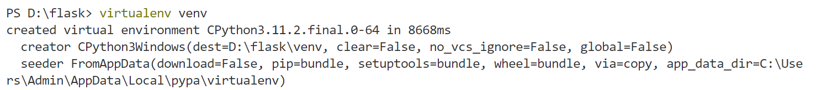
Using virtual environment
Make a directory and move into the directory
mkdir flask
cd flask
Install virtualenv
Create a virtual environment
Notes:
Or alternative try
python -m venv venv
.\venv\Scripts\activate

Slide 6
Activate virtual environment
install flask environment within virtual environment
>pip install flask
Notes:
pip install --trusted-host pypi.python.org --trusted-host pypi.org --trusted-host files.pythonhosted.org flask

Slide 7
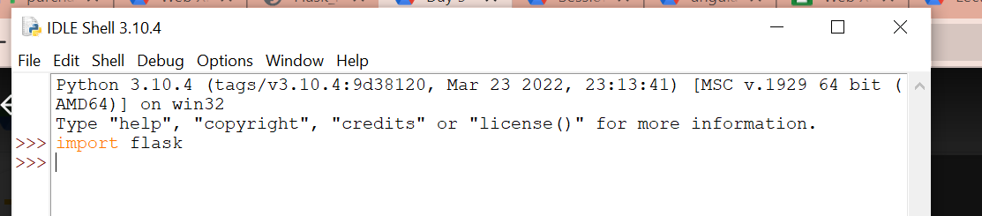
Verify if flask has been installed property
Open IDLE
Import flask command should not through an error

Slide 8
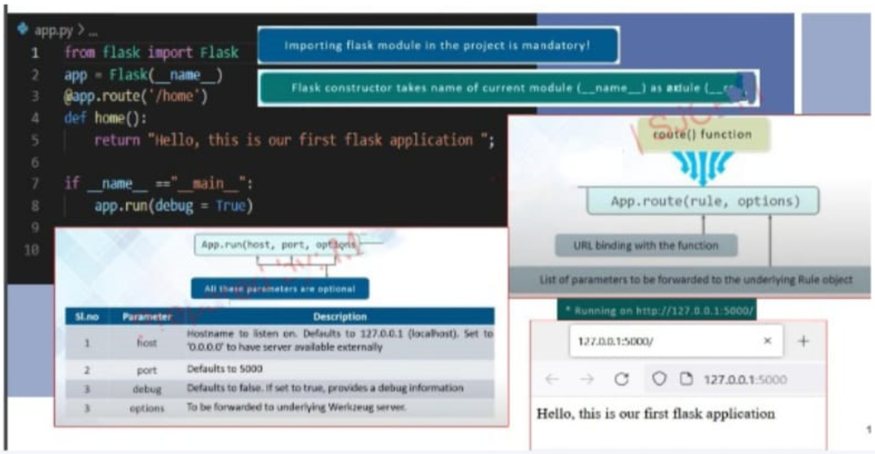
First App

Slide 9
To run the app
python -m flask --app .\app.py run
Or just
python -m flask run

Slide 10
App Routing
This helps the user remember the URLs.
Routes in Flask are mapped to Python functions
The route() decorator, @app.route(), binds a URL to a function.
If you want the route /hello, you can bind it to the hello_world() function like this:
Parameters can be used when creating routes. A parameter can be a string (text) like this: /product/cookie. ( make URL Dynamic)
@app.route('/product/<name>')
def get_product(name):
return "The product is " + str(name)
@app.route('/') def index():
@app.route('/hello') def hello_world(): return "hello world"

Slide 11
Alternative for app routing is addURL
This approach is mainly used in case we are importing the view function from another module
Don’t need decorator
Just add functions
add_url_rule(<url rule>, <endpoint>, <view function>)
def show_user(username):
# Greet the user
return f'Hello {username} !'
app.add_url_rule('/user/<username>', 'show_user', show_user)
if __name__ == "__main__":
app.run(debug=True)

Slide 12
URL Building
The url_for() function is used to build a URL to the specific function dynamically.
The first argument is the name of the specified function, and then we can pass any number of keyword argument corresponding to the variable part of the URL.
This function is useful in the sense that we can avoid hard-coding the URLs into the templates by dynamically building them using this function.

Slide 13
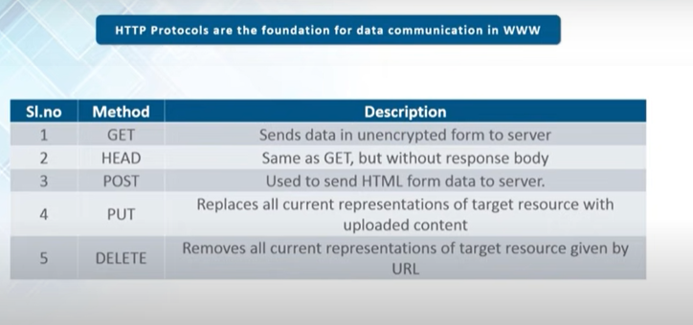
Flask HTTP Method

Slide 14
Templates - Jinja
Flask uses templates to expand the functionality of a web application while maintaining a simple and organized file structure.
Templates are enabled using the Jinja2 template engine and allow data to be shared and processed before being turned in to content and sent back to the client.
Jinja template library to render templates
Integrate some datasource to render it as a HTML page
Feature
Sandbox execution mode.
Powerful automatic HTML escaping system for cross site scripting prevention.
Template inheritance which makes it possible to use similar layout for all templates.
Easy to debug with debugging system that integrates compile and runtime errors into standard Python traceback system.
Optional Ahead of time template compilation.

Slide 15
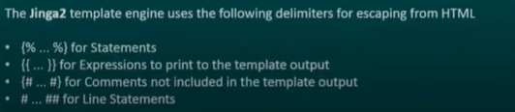
flask will try to find the HTML file In the template folder, in the same folder in which the script is present
render_template() function renders HTML files for display in the web browser
Handy when you need to create dynamic pages

Slide 16
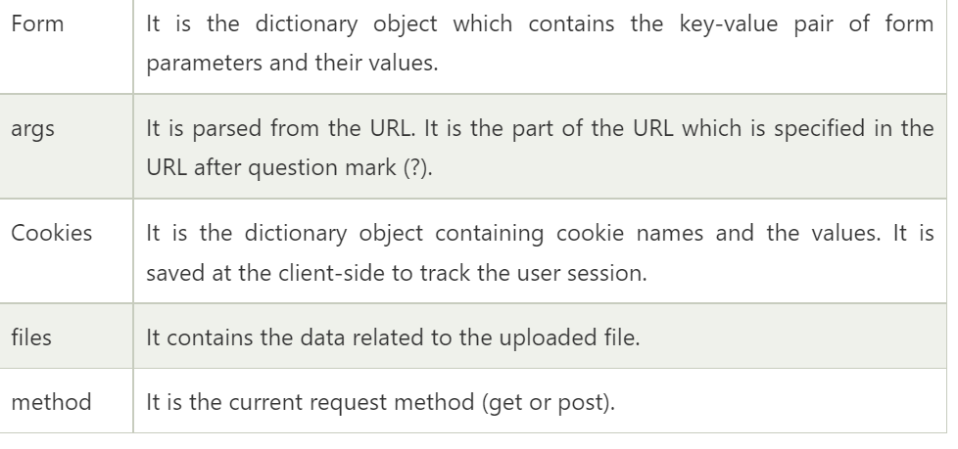
Flask Request Object
Web applications frequently require processing incoming request data from users.
This payload can be in the shape of query strings, form data, and JSON objects.
Flask, like any other web framework, allows you to access the request data.

Slide 17
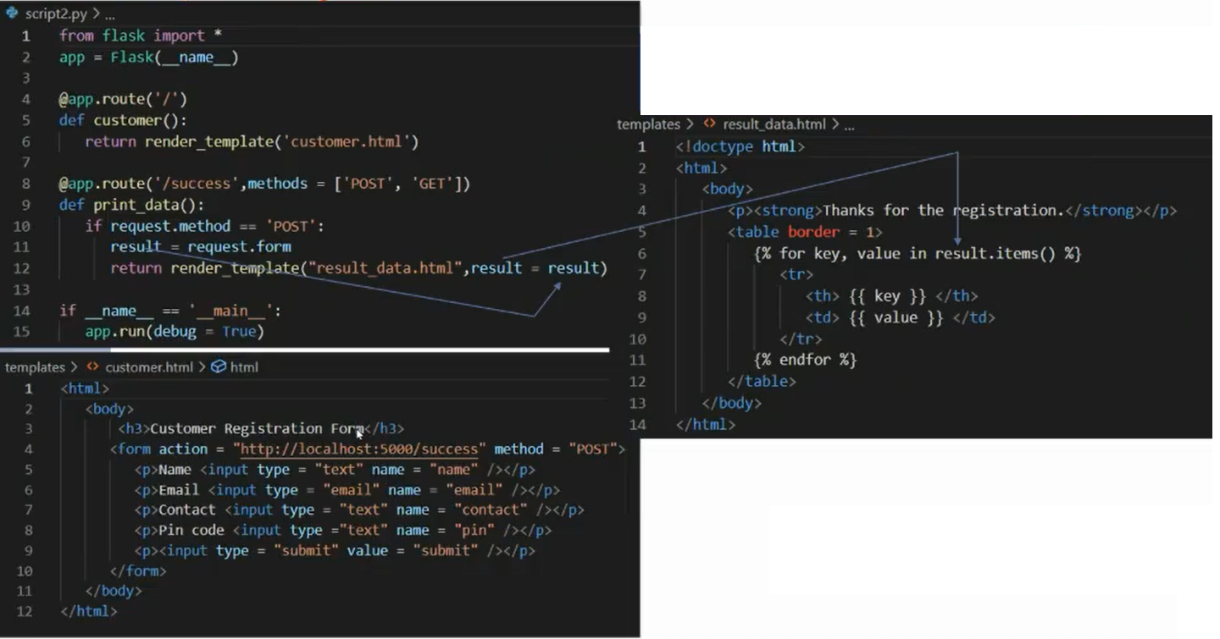

Slide 18
Flask cookies
Cookies are stored on the client’s computer as text files.
Aim is to remember and track data that is relevant to customer usage for better visitor experience and website statistics.
The Flask Request object contains the properties of the cookie.
It is a dictionary object for all cookie variables and their corresponding values, and the client is transferred.In addition to this, cookies also store the expiration time, path, and domain name of its website.
Cookies are set on the response object.
Server sends the Cookie to the user along with the response. It is done using the make_response() function.
Once the response is set, we use the set_cookie() function to attach the cookie to it.

Slide 19
The cookie takes the attributes:
response.set_cookie('<Title>','<Value>','<Expiry Time>')
The cookie is sent back along with the Request to the server.
to get the Cookie back from the user, use request.cookies.get() function.

Slide 20
File Uploading
File uploading is the process of transmitting the binary or normal files to the saver.
It requires an HTML form whom enctype property is set to "multipart/form-data" to publish the file to the URL.
The server side flask fetched the file from the request object using request.files[ ] Object.
On successfully uploading the file, it is saved to the desired location on the server

